Slide 1
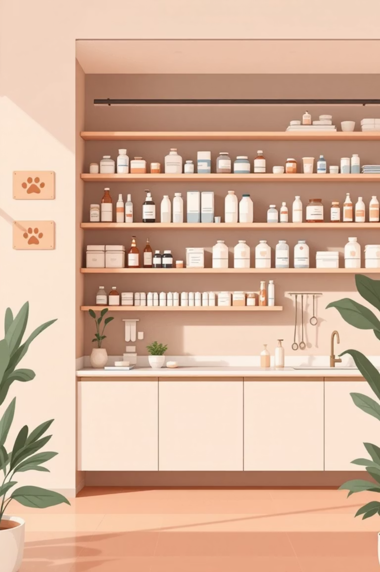
Pet Vet – Activity Diagram for Medication Purchase
Course: IT 501 FA2025 VH1
Date: October 27, 2025

Slide 2

Overview of Scenario
This activity diagram models the complete workflow when a Pet Vet staff member purchases medications and supplies through an online ordering system. The process encompasses every critical step—from initial browsing through the product catalog to final payment processing and order fulfillment.
Primary Goal: To demonstrate how the Pet Vet system seamlessly integrates with PayPal's payment infrastructure and the fulfillment department to complete secure online transactions efficiently.

Slide 3

Actors & Swimlanes
The purchasing process involves coordination between three distinct actors, each represented by their own swimlane in the activity diagram:
Pet Vet Staff Member
PayPal System
Fulfillment Department
Initiates the process by browsing the medication catalog, selecting items, and managing the shopping cart through checkout
Serves as the payment gateway, handling authorization, verification, and secure transaction processing
Receives approved orders, prepares shipments, and sends confirmation notifications to complete the cycle

Slide 4
Pet Vet Staff Member Activities
The staff member's workflow follows a logical sequence of actions within their designated swimlane:
01
02
System Login & Initialization
Browse Medication Catalog
Staff member accesses the Pet Vet ordering platform with secure credentials
Navigate through available medications, supplies, and veterinary products
03
04
Select & Add Items
Decision Point
Choose specific medication and add to the shopping cart with quantity specifications
"Add more items?" If yes → return to browsing. If no → proceed to checkout
05
06
Payment Method Selection
Submit Payment Request
Choose PayPal as the preferred payment gateway for secure transaction processing
Transmit payment information to PayPal system for authorization

Slide 5

PayPal & Fulfillment Activities
PayPal System
Fulfillment Department
Receive Payment Request
Order Reception
Accept transaction details from Pet Vet system
Receive notification of approved purchase order
Verification Process
Package Preparation
Validate payment information and approve or decline based on security checks
Gather medications and supplies, prepare for shipment
Send Confirmation
Ship Order
Transmit payment authorization back to Pet Vet platform
Dispatch package via designated carrier with tracking
Trigger Fulfillment
Confirmation Email
Notify fulfillment department of approved order
Send shipment confirmation and tracking details to staff member, completing the process

Slide 6
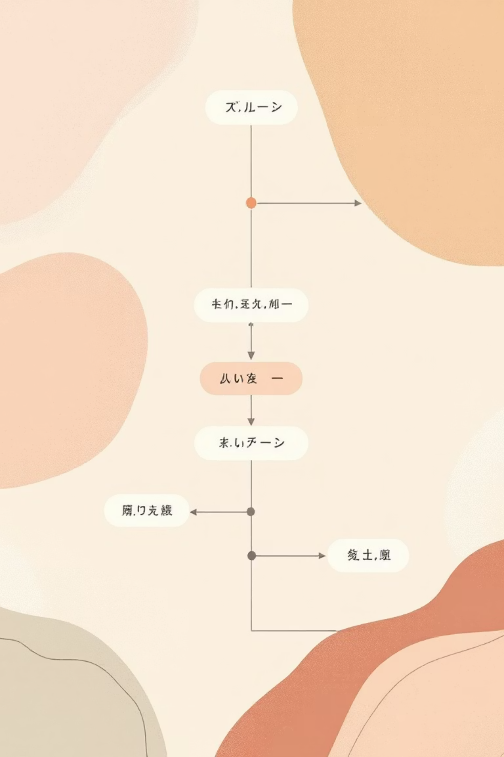
Activity Diagram – Complete Process Flow

Slide 7
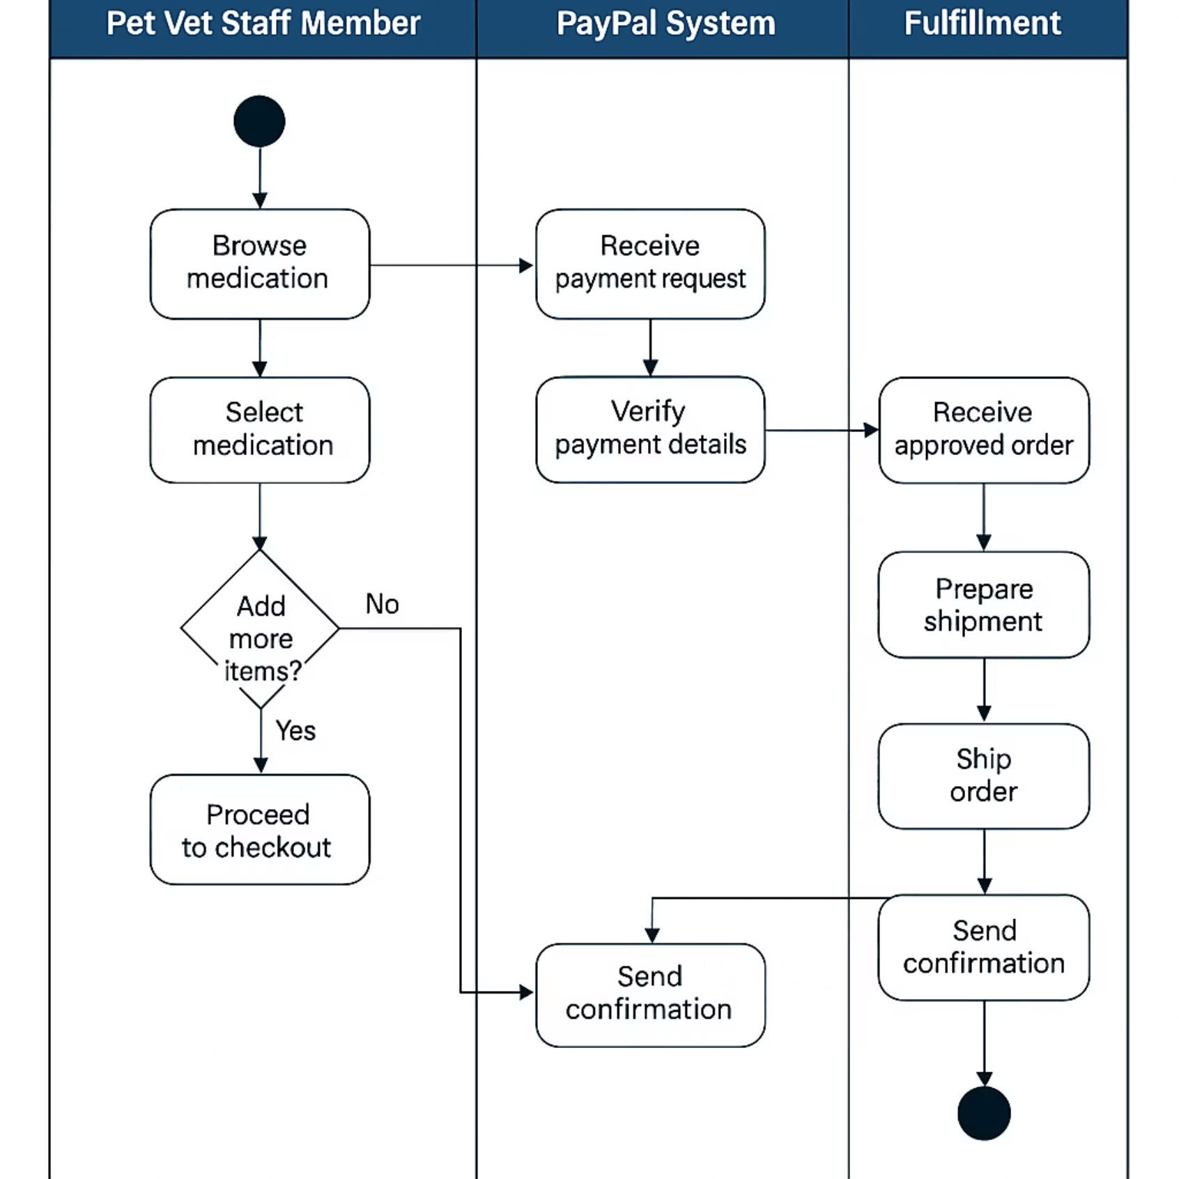
Activity Diagram

Slide 8
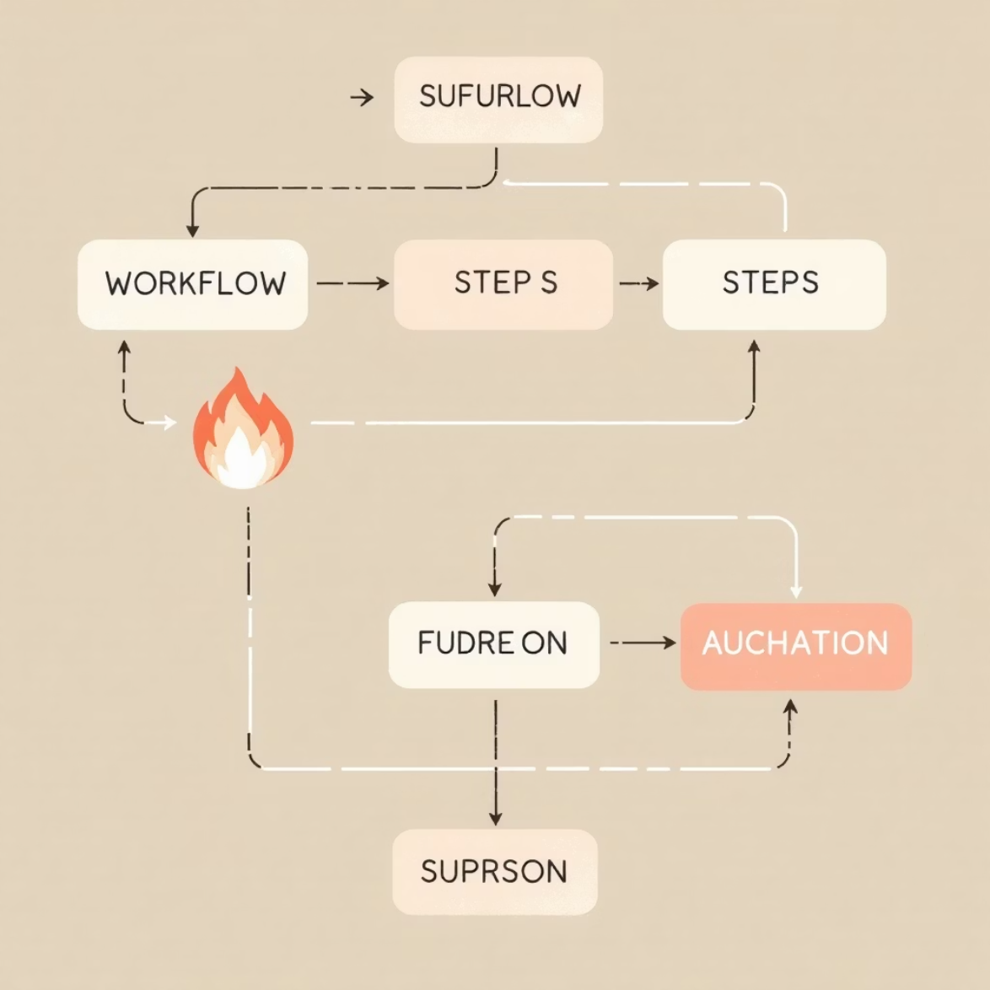
Process Logic Summary
The activity diagram captures the complete purchasing workflow with precise logical flow:
Iterative Shopping Cart Loop
Staff member can browse and add multiple items through a decision loop before proceeding to checkout
Payment Gateway Integration
Checkout phase triggers PayPal verification process with approval/decline decision point
Automated Fulfillment Notification
Upon successful payment authorization, fulfillment receives immediate notification
Closed-Loop Confirmation
Fulfillment completes the cycle by shipping items and sending confirmation back to the originating user
UML Compliance: The diagram follows standard UML notation with proper use of decision nodes, merge nodes, activity flows, and swimlane boundaries to demonstrate accurate logical sequencing.

Slide 9

Conclusion
This comprehensive activity diagram successfully models the complete online medication purchasing workflow for Pet Vet, demonstrating:
Clear Role Separation
Symbol Accuracy
Distinct division of responsibilities across user interface, payment processing, and order fulfillment
Correct application of UML activity diagram conventions including swimlanes, decision nodes, and control flow
Logical Consistency
Coherent process flow demonstrating loops, conditional branches, and sequential activities

